Slide 1
“Otherwise, Our Civilization Will Stagnate and Die” Tennessee Conference of the AAUP
Patrick Pauken, JD, PhD
Bowling Green State University
April 22, 2022

Slide 2
Thank You!
Josephine McQuail and the Tennessee Conference of the AAUP
The incomparable, life-long friend – Carole de Casal!

Slide 3
Welcome to the Coffeehouse
I have no idea what I will offer this weekend that is not already in your heads and hearts…
But nearing the end of long semester, year, and pandemic, you give me an opportunity to remind myself – and I hope remind you, as well – why the best of what exhausts us … also restores us.
Welcome to the coffeehouse … where ALL VOICES have a front-row seat.

Slide 4
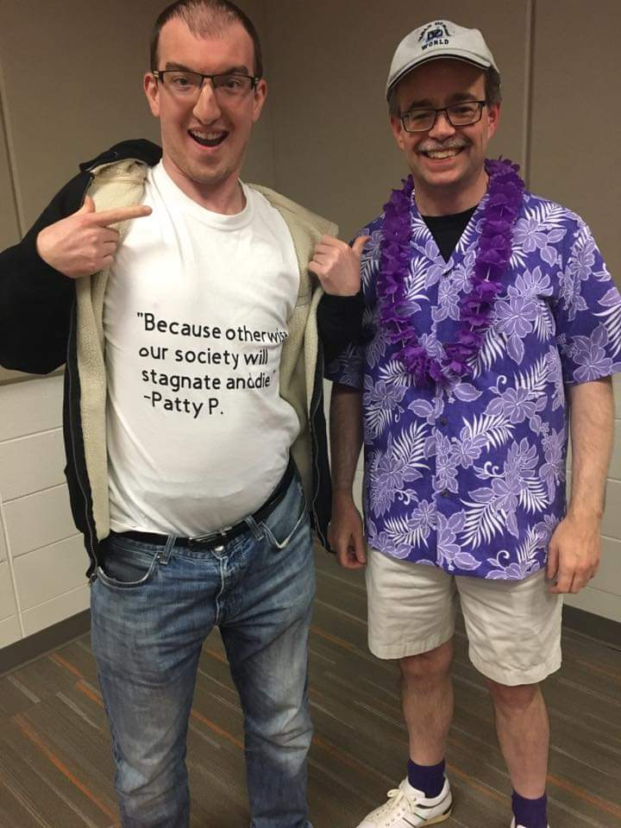
Sam Clary and I – Higher Education Law (10/31/2018)

Slide 5
My favorite! From Sweezy v. New Hampshire (1957)
“The essentiality of freedom in the community of American universities is almost self-evident. No one should ever underestimate the vital role in a democracy that is played by those who guide and train our youth. To impose any strait jacket upon the intellectual leaders in our colleges and universities would imperil the future of our Nation. No field of education is so thoroughly comprehended . . . that new discoveries cannot yet be made. . . . Teachers and students must always remain free to inquire, to study and to evaluate, to gain new maturity and understanding. Otherwise our civilization will stagnate and die.”

Slide 6
Sam Clary, now a Student Support Specialist at Purdue University, quoted/paraphrased Justice Warren and attributed that gloriousness to me – on Halloween – in a higher education law class.
In a coffeehouse.
I’ll take it! . . . But what will I do with it? . . . What will we do with it?

Slide 7
Overview of Today and Tomorrow
Friday: Freedom of Speech and Expression (generally)
Employees
Largely public employees (the First Amendment)
Private Universities, too!
The “Hats” We Wear
Students
Inviting them to the coffeehouse, too!
… with a teaser for Academic Freedom

Slide 8
Saturday: Academic Freedom
Legal, Constitutional Meaning
Sweezy and Keyishian – again, for good measure
Professional Meaning
AAUP
Contractual Applications
“Academic Freedom” as a bargainable issue (my experience at BGSU)
Teaching, Research, and Service
Tennessee SB 2290 and HB 2670 – the “divisive concepts” bill
Applications
Faculty
Students

Slide 9
First Amendment of the U.S. Constitution
“Congress shall make no law respecting an establishment of religion, or prohibiting the free exercise thereof; or abridging the freedom of speech, or of the press; or the right of the people peaceably to assemble, and to petition the Government for a redress of grievances.”
The First Amendment acts as a restriction on government action in recognition of free speech and other rights.
It’s all about balance!

Slide 10
Free Speech in Higher Education: The Foundational Cases
Sweezy v. New Hampshire (1957)
A due process case about the investigation of a college lecturer who was rumored to be a member of “subversive organizations.” The state law prohibited public employment for “subversive persons.”
Sweezy was questioned for his alleged subversive activities. He declined to answer several questions on First Amendment grounds. Held in contempt.
Issue related the statute’s investigatory processes (and less direct to free speech).
Ruling: For Sweezy!

Slide 11
So nice, we say it twice! From Sweezy:
Justice Warren (majority): “. . . . Teachers and students must always remain free to inquire, to study and to evaluate, to gain new maturity and understanding. Otherwise our civilization will stagnate and die.”
Justice Frankfurter (concurring): “In a university knowledge is its own end, not merely a means to an end. A university ceases to be true to its own nature if it becomes the tool of Church or State or any sectional interest. A university is characterized by the spirit of free inquiry, its ideal being the ideal of Socrates — ‘to follow the argument where it leads.’”

Slide 12
Free Speech in Higher Education: The Foundational Cases
Keyishian v. Board of Regents (1967)
Employees at the University of Buffalo, formerly a private institution, became public employees when Buffalo merged with the SUNY system. State statutory law and associated regulations prohibited public employment for those in “subversive organizations.”
Issue: Whether this state program violated the First Amendment.
Ruling: Yes!

Slide 13
From Keyishian
“Our Nation is deeply committed to safeguarding academic freedom, which is of transcendent value to all of us and not merely to the teachers concerned. That freedom is therefore a special concern of the First Amendment, which does not tolerate laws that cast a pall of orthodoxy over the classroom.”
“The vigilant protection of constitutional freedoms is nowhere more vital than in the community of American schools. The classroom is peculiarly the ‘marketplace of ideas.’ The Nation's future depends upon leaders trained through wide exposure to that robust exchange of ideas which discovers truth "out of a multitude of tongues, [rather] than through any kind of authoritative selection....”

Slide 14
A “Special Concern”? Says who? . . . Are we really that special?
If academic freedom really is a “special concern” of the First Amendment, as the Court in Keyishian states, …
Why is this so?
How has it been recognized as such in the 55 years since Keyishian?
Whether or not we like the distinciton academic freedom has received, what is our leadership imperative as higher education professionals?
How do we practice such advocacy? What does it look like?
(Road trips are cool. Tennessee and Ohio are not that far apart.

Slide 15
The Hats We Wear
An Analytical Framework for Public Employee Speech
Teacher as Citizen → State as Sovereign
Teacher as Employee → State as Employer
Teacher as Educator → State as Educator

Slide 16
Pickering v. Board of Education (1968)
“Teacher” as Citizen → State as Sovereign
Marvin Pickering, a local teacher, wrote a letter to the editor, criticizing the board of education (his employer) over the board’s alleged use of taxpayer money
The board terminated Pickering’s employment. Pickering sued.

Slide 17
Pickering
The Court in Pickering held that the subject of the letter was a “matter of public concern” (MOPC), also finding that Pickering was acting in his capacity as a citizen when he wrote the letter.
What is the reasoning on this finding? Do you agree?
Once we determine that the teacher/citizen’s speech is related to a MOPC, what other factors do we look at to determine whether the employer (state actor) may restrict the speech/conduct?

Slide 18
The Pickering Factors
The Pickering Factors
Was the speech related to a MOPC?
Impact of speech/conduct on
Work of the teacher
Work of the employer/school/university
Capacity (“hat”) of the speaker
Proximity of speaker/speech to the “target”

Slide 19
Pickering – a Key Quote
From Pickering
“[A]bsent proof of false statements knowingly or recklessly made by him, a teacher’s exercise of his right to speak on issues of public importance may not furnish the basis for his dismissal from public employment.”
Note: Much of what Pickering said was, indeed, false and misleading. But there was no negative impact on Board work. There is an interesting defamation discussion in Pickering, too. Paraphrased: While there are some necessary limits to our speech rights, “Board members! If you can’t stand the heat, get out of the kitchen.”

Slide 20
Connick v. Myers (1983)
“Teacher” as Employee → State as Employer
Employer discretion? …
What’s inside stays inside (matters of internal concern earn employer discretion)
“When employee expression cannot be fairly considered as relating to any matter of political, social, or other concern to the community, government officials should enjoy wide latitude in managing their offices, without intrusive oversight by the judiciary….”

Slide 21
The Pickering-Connick Factors
In a Pickering-Connick analysis, the MOPC question becomes primary.
Was the speech related to a MOPC? (If yes, then…)
-------------------------------------------------------------
Impact of speech/conduct on
Work of the teacher
Work of the school
Capacity (“hat”) of the speaker
Proximity of speaker/speech to the “target”

Slide 22
Pickering, Connick, and Social Media
Social media commentary by our teachers and staff!
Politics (ugh)
Private stuff (TMI!)
Matters of public concern? (Really? Are you sure?)
Proposed/actual state laws on the banning of “CRT” and “don’t say ‘gay’”?
So, now what? These have been quite a few years!!
Many public employees have taken to their personal social media accounts with their rants. On matters of public concern? As citizens? Employees?
What’s the public employer to do? How do we respond to calls for termination and/or other discipline?
What about social media searches when we’re hiring?

Slide 23
Garcetti v. Ceballos (2006)
“Teacher” as Employee → State as Employer
Assistant district attorney sued his employer after he was allegedly treated unfairly (retaliation) at work – reassignment, transfer, and denial of promotion – after a disagreement with his employer over the viability of search warrant in a criminal case.
Does our public employee speech qualify for First Amendment protection?

Slide 24
Garcetti v. Ceballos and “Pursuant to Official Duties”
When you talk while wearing the employee hat and while pursuant to official duties
“[W]hen public employees make statements pursuant to their official duties, the employees are not speaking as citizens for First Amendment purposes, and the Constitution does not insulate their communications from employer discipline.”

Slide 25
Garcetti Implications
So what are the pros and cons of this decision for higher education?
How should Garcetti’s “pursuant to official job duties” ruling be treated in public higher education?
Surely, faculty at public colleges and universities are qualitatively different from other public employees? Our speech is different and worthy of special consideration. Right?
What about other higher education professionals (administrators, administrative staff, student affairs professionals, etc.)?

Slide 26
Garcetti v. Ceballos: Souter Dissent
“….This ostensible domain [of speech] beyond the pale of the First Amendment [created by the majority] is spacious enough to include even the teaching of a public university professor, and I have to hope that today’s majority does not mean to imperil First Amendment protection of academic freedom in public colleges and universities, whose teachers necessarily speak and write ‘pursuant to … official duties.’”

Slide 27
Garcetti: The Back-and-forth between Roberts (majority) and Souter (dissent)
From the majority:
“Justice Souter [writing in dissent] suggests today’s decision may have important ramifications for academic freedom, at least as a constitutional value. There is some argument that expression related to academic scholarship or classroom instruction implicates additional constitutional interests that are not fully accounted for by this Court’s customary employee-speech jurisprudence. We need not, and for that reason do not, decide whether the analysis we conduct today would apply in the same manner to a case involving speech related to scholarship or teaching.”

Slide 28
Garcetti follow-up
So, is there a “Garcetti exception” for academic freedom of faculty?
If so, how do we make it so? Hang out and wait for the courts?

Slide 29
Garcetti: Application to Universities?
Pre-Garcetti
Hardy v. Jefferson Cmty. Coll. (6th Cir. 2001).
Bishop v. Aronov (11th Cir. 1991).
Post-Garcetti
Demers v. Austin (9th Cir, 2014).
Adams v. UNC-Wilmington (4th Cir. 2011).
Meriwether v. Hartop (6th Cir. 2021).

Slide 30
From Hardy v. Jefferson County Community College:
The court in Hardy v. Jefferson Community College spoke to the issue of whether the controversial speech was “germane” to the topic being taught. Clearly, the “germaneness of the content” argument is a strong one.
“Because the essence of a teacher’s role is to prepare students for their place in society as responsible citizens, classroom instruction will often fall within the Supreme Court’s broad conception of ‘public concern.’”

Slide 31
From Hardy:
So a law course is always related to an MOPC? Stats class, never?
Would the quote from Hardy hold up post-Garcetti?

Slide 32
From Bishop v. Aronov (1991)
“First and foremost, we consider the context: the university classroom…. This context … leads us to consider the coercive effect upon students that a professor’s speech inherently possesses and that the University may wish to avoid.”
As a place of schooling with a teaching mission, we consider the University’s authority to reasonably control the content of its curriculum, particularly that content imparted during class time.”
“[W]e do not find support to conclude that academic freedom is an independent First Amendment right.”

Slide 33
The Recent Garcetti Exceptions
Demers v. Austin (9th Cir. 2014)
Adams v. UNC-Wilmington (4th Cir. 2011)
Meriwether v. Hartop (6th Cir. 2021)
. . . OK, but are these the poster children academic freedom needs?

Slide 34
From Demers (2014):
In Demers v. Austin, the court discusses a “Garcetti exception” applied to teaching and academic writing and takes the analysis down a different path.
“Justice Souter had expressed concern about the potential breadth of the Court's rationale, writing, ‘I have to hope that today's majority does not mean to imperil First Amendment protection of academic freedom in public colleges and universities, whose teachers necessarily speak and write pursuant to . . . official duties.’
“Demers presents the kind of case that worried Justice Souter. . . . teaching and academic writing are at the core of the official duties of teachers and professors. Such teaching and writing are "a special concern of the First Amendment.”

Slide 35
Demers (as a person and as a case)…
… makes me angry.
Am I the only one?
“The manner in which the plan was distributed reinforces the conclusion that it addressed matters of public concern.”
What? I thought the MOPC was inspired by content and not process.
He goes out of his way to avoid official business (when it really was official business) … and now he’s protected?
Sigh.

Slide 36
Adams v. UNC-Wilmington (2011)
Faculty member claimed free speech violation after he was denied promotion, allegedly due to his conservative political views. (Views expressed in radio and television, as well as a published book of essays.)
Court held for Adams: “The plain language of Garcetti … explicitly left open the question of whether its principles apply in the academic genre where issues of ‘scholarship and teaching are in play.”
Hence, the analysis found in the Pickering-Connick standard apply to such cases, that is, whether the faculty member is speaking as a citizen on a matter of public concern.

Slide 37
Meriwether v. Hartop (2021)
Oh, Socrates! What are we going to do with you?
. . . “Follow the argument where it leads”?
Public university violated professor’s First Amendment free speech rights when mandating the use of students’ preferred pronouns.

Slide 38
The Hats We Wear
Firestarter
Firefighter
“Part-time Lawyer”
“All-around hoped-for ‘Good Guy’”

Slide 39
Academic Freedom, Representation, and Advocacy:
. . . More Tomorrow!
“Otherwise, our civilization will stagnate and die.”

